Slide 1

RX JAVA & NOTIFICATION
Start
Advanced Native Mobile Programming
Week 7
Teknik Informatika - Universitas Surabaya

Slide 2
RX JAVA
Go!

Slide 3
RX JAVA
RX Java is huge topic (see https://reactivex.io/)
RX Java is third party library
RX Java is reactive asynchronous programming paradigm
Reactive programming is a programming paradigm oriented around data flows and the propagation of change (more reading: https://www.techtarget.com/searchapparchitecture/definition/reactive-programming)
Asynchronous means a program waits in an indeterminate amount of time for the response. Ex: API calls
The goal of RXJava is to improve User Experiences

Slide 4
RX JAVA COMPONENT
Observable An object that emit the data periodically or only once in their life cycle based on their configurations.
Observes (Subscribers) Observers consumes the data stream emitted by the observable.
Schedulers tells observable and observers, on which thread they should run

Slide 5
RX JAVA DEPENDENCIES
RxJava (https://github.com/ReactiveX/RxJava) RX Java is reactive asynchronous programming paradigm implementation "io.reactivex.rxjava3:rxjava:3.1.3"
RxAndroid (https://github.com/ReactiveX/RxAndroid) RxAndroid is an extension to RxJava. It providers a scheduler to run code in the main thread of Android. implementation 'io.reactivex.rxjava3:rxandroid:3.0.0'
RxKotlin (https://github.com/ReactiveX/RxKotlin) RxKotlin augments the RxJava library with an API designed with Kotlin in mind (using extension) implementation "io.reactivex.rxjava3:rxkotlin:3.0.1"

Slide 6
RX JAVA - simple EXAMPLE
Create an Observable
val observable = Observable.just("a stream of data","hellow","world")
This observable emits collection of Strings

Slide 7
RX JAVA - CREATE OBSERVER
val observer = object : Observer<String> {
override fun onSubscribe(d: Disposable?) {
Log.d("Messages", "begin subscribe")
}
override fun onNext(t: String?) {
Log.d("Messages", "data: $t")
}
override fun onError(e: Throwable?) {
Log.e("Messages", "error: ${e!!.message.toString()}")
}
override fun onComplete() {
Log.d("Messages", "complete")
}
}

Slide 8
RX JAVA - CREATE OBSERVER
onNext() : This method will be called when there is any new data emitted by the observable. The object that is emitted by the observable can be found in argument parameters of this callback.
onError() : You will receive this callback whenever there is any error occurred on observable. (After all the world is not perfect.)
onComplete() : Whenever observable is done with emitting the data streams, you will receive this callback. This indicates that there is no more data to emit.

Slide 9
RX JAVA - Scheduler
Most common activities in handling asynchronous tasks is to observe the output of task on the main thread because you want to update the UI
observable
.subscribeOn(Schedulers.io())
.observeOn(AndroidSchedulers.mainThread())
.subscribe(observer)

Slide 10
RX JAVA - Scheduler
subscribeOn() : By using this method you can define on which thread the observable should run. Schedulers.io() indicates the IO thread. While Schedulers.newThread() will create a new thread to run observer/observable
observeOn() : By using this method you can define on which thread the observer should run.

Slide 11
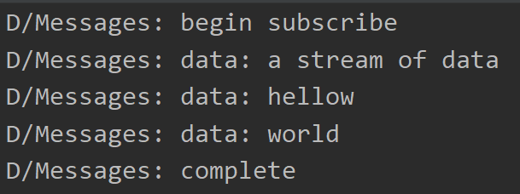
OUTPUT
Output in Logcat

Slide 12
RX JAVA - MAKE IT SIMPLE
Observable can use extension functions to simplify codes. For example just method here:
Observable.just("a stream of data","hellow","world") .subscribe(
{ Log.d("Messages", it) },
{ Log.e("Messages", it.message.toString()) },
{ Log.d("Messages", "Completed") }
)
Next
Error
Complete

Slide 13
RX JAVA - DELAY OBSERVABLE (TIMER)
An Observable that emits a particular item after a given delay
Observable.timer(5, TimeUnit.SECONDS)
.subscribeOn(Schedulers.io())
.observeOn(AndroidSchedulers.mainThread())
.subscribe {
Log.d("Messages", "five seconds")
}
Similar like timer. The observable emit delayed 5 seconds

Slide 14
ANDROID NOTIFICATION
Go!

Slide 15
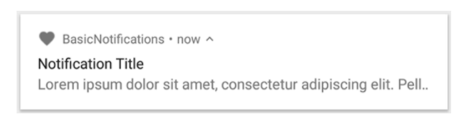
ANDROID NOTIFICATION
A notification in its most basic and compact form (also known as collapsed form) displays an icon, a title, and a small amount of content text.

Slide 16
ANDROID NOTIFICATION
NotificationCompat.Builder is responsible to create notification object that consist of:
A small icon, set by setSmallIcon(). This is the only user-visible content that's required.
A title, set by setContentTitle().
The body text, set by setContentText().
The notification priority, set by setPriority(). The priority determines how intrusive the notification should be

Slide 17
ANDROID NOTIFICATION - EXAMPLE
var builder = NotificationCompat.Builder(this, CHANNEL_ID)
.setSmallIcon(R.drawable.notification_icon)
.setContentTitle(textTitle)
.setContentText(textContent)
.setPriority(NotificationCompat.PRIORITY_DEFAULT)
Notice that the NotificationCompat.Builder constructor requires that you provide a channel ID. This is required for compatibility with Android 8.0 (API level 26) and higher, but is ignored by older versions.

Slide 18
ANDROID NOTIFICATION - DISPLAY NOTIFICATION
val notificationManager = NotificationManagerCompat.from(context)
notificationManager.notify(1001, notificationBuilder.build())
To make the notification appear, call NotificationManagerCompat.notify(), passing it a unique ID for the notification and the result of NotificationCompat.Builder.build()

Slide 19
NOTIFICATION CHANNEL
Starting in Android 8.0 (API level 26), all notifications must be assigned to a channel.
For each channel, you can set the visual and auditory behavior that is applied to all notifications in that channel.

Slide 20
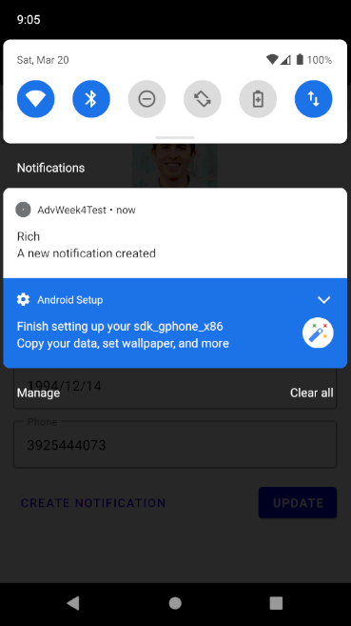

TUTORIAL
SHOW NOTIFICATION
RX Java
The goal of the tutorial is to create notification that triggered after 5 seconds
To achieve this, we use RXJave Timer
Notification

Slide 21
CREATE SHOW NOTIFICATION FUNCTION
Back
Notification requires a context object
Therefore we create a function in MainActivity (that hold the context), and because Main Activity is the central part of MVVM architecture
However, to make this function callable in all fragment or activities, we should put the function inside a companion object

Slide 22
MAIN ACTIVITY
Back
This is a workaround solution to get access of context object within activity
class MainActivity : AppCompatActivity() {
init {
instance = this
}
companion object {
private var instance:MainActivity ?= null
}
. . .

Slide 23
MAIN ACTIVITY
Back
companion object {
private var instance:MainActivity ?= null
fun showNotification(title:String, content:String, icon:Int) {
val channelId = "${instance?.packageName}-${instance?.getString(R.string.app_name)}"
}
Channel ID is unique string that use as identifier notification to current app

Slide 24
MAIN ACTIVITY
Back
fun showNotification(title:String, content:String, icon:Int) {
val channelId = "${instance?.packageName}-${instance?.getString(R.string.app_name)}"
val notificationBuilder = NotificationCompat.Builder(instance!!.applicationContext, channelId).apply {
setSmallIcon(icon)
setContentTitle(title)
setContentText(content)
setStyle(NotificationCompat.BigTextStyle())
priority = NotificationCompat.PRIORITY_DEFAULT
setAutoCancel(true)
}
}
Channel ID
Notification Builder

Slide 25
MAIN ACTIVITY
Back
fun showNotification(title:String, content:String, icon:Int) {
val channelId = . . .
val notificationBuilder = . . .
val notificationManager = NotificationManagerCompat.from(instance!!.applicationContext.applicationContext!!)
notificationManager.notify(1001, notificationBuilder.build())
}
Access context object

Slide 26
CREATE NOTIFICATION CHANNEL
Back
Open your Util.kt, add following function
fun createNotificationChannel(context: Context, importance: Int, showBadge: Boolean, name: String, description: String) {
if (Build.VERSION.SDK_INT >= Build.VERSION_CODES.O) {
}
}
It check current platform if greater than Android Oreo than we need notification channel

Slide 27
CREATE NOTIFICATION CHANNEL
Back
if (Build.VERSION.SDK_INT >= Build.VERSION_CODES.O) {
val channelId = "${context.packageName}-$name"
val channel = NotificationChannel(channelId, name, importance)
channel.description = description
channel.setShowBadge(showBadge)
val notificationManager = context.getSystemService(NotificationManager::class.java)
notificationManager.createNotificationChannel(channel)
}

Slide 28
CALL THE NOTIFICATION CHANNEL
Back
We call the notification channel method in Main Activity onCreate
createNotificationChannel(this,
NotificationManagerCompat.IMPORTANCE_DEFAULT, false,
getString(R.string.app_name), "App notification channel.")

Slide 29
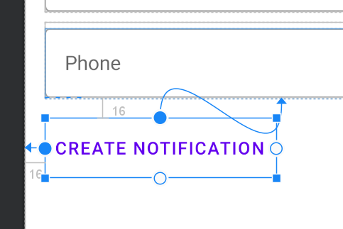
CALL THE NOTIFICATION
Back
Now open the fragment_student_detail.xml, and add the create notification button
Style -> @style/Widget.MaterialComponents.Button.TextButton Id = -> btnNotif

Slide 30
LISTENER - RX JAVA
Back
Add following listener within the studendLD.observe function
var student = it
It refer to student object from LiveModel

Slide 31
LISTENER - RX JAVA
Back
var student = it
btnNotif.setOnClickListener {
Observable.timer(5, TimeUnit.SECONDS)
.subscribeOn(Schedulers.io())
.observeOn(AndroidSchedulers.mainThread())
.subscribe {
Log.d("Messages", "five seconds")
MainActivity.showNotification(student.name.toString(),
"A new notification created",
R.drawable.circle)
}
}
Student name taken from Student object live data
You may use whatever drawable icon you have

Slide 32
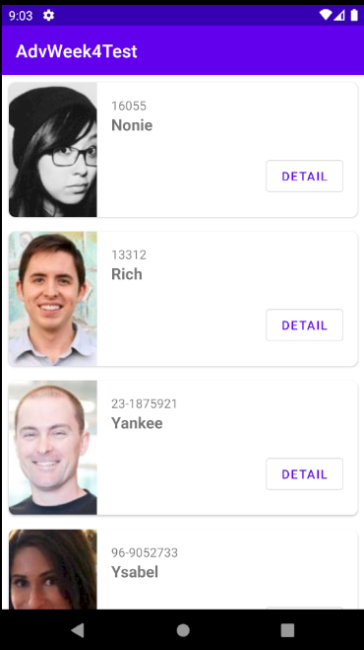
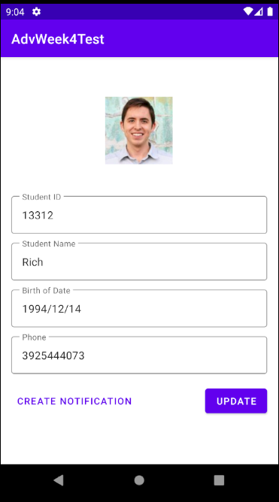
OUTPUT
Back
Click the button, and wait 5 seconds to see the notification appear.

Slide 33
SELF STUDY
Back
Explore other RXJava function like flowable, single, maybe, disposable, and others
Explore the advanced notifications that include broadcast service, pending intent, styling the notification, and so on

Slide 34
THANKS!
Do you have any questions?
andre@staff.ubaya.ac.id
Please keep this slide for attribution.

Slide 35


